Slide 1
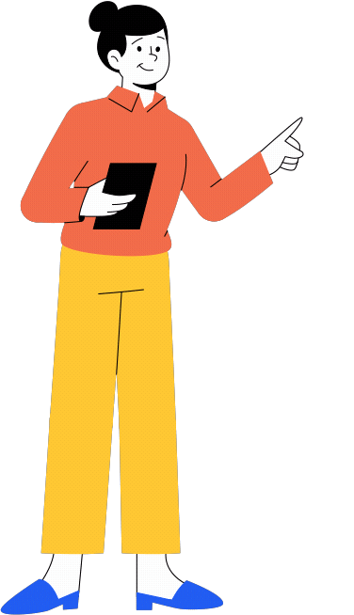

2048 GAME
START!

Slide 2

A Project on
2048 GAME
As a partial fulfilment of BCA Semester-VI
Batch (2024-2025)
Under taken at
Matrushree L. J. Gandhi(bakorvala) BCA Collage, Modasa
Submitted by
Name | Roll No | Exam No
Faizan Shekh | 108(Div-B)
Mo.Ayan Belim | 05(Div-A)
Submitted to
Matrushree L. J. Gandhi(bakorvala) BCA Collage, Modasa

Slide 3
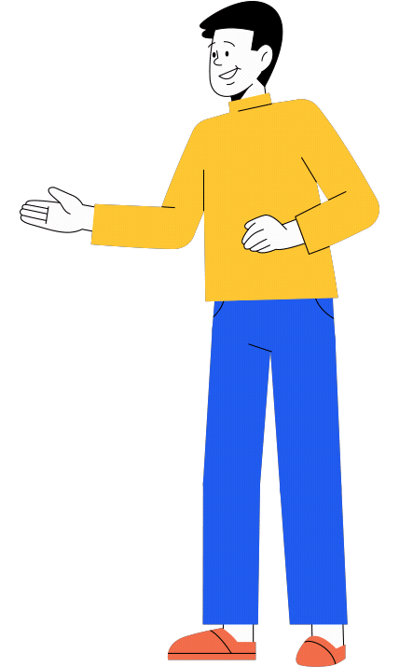
PROJECT PROFILE
Project Title | 2048 Game
Goal Of System | Entertainment
Type of Application | Web-based Application
Fronted & Backend | Html, css & Javascript
Tool Used | Visual Studio Code[IDEs]
Internal Guide | Hemali Patel
Devloped By | Faizan Shekh & Mo.Ayan Belim

Slide 4

EXISTING SYSTEM
Limited Grid Size: The standard 4×4 grid restricts extended gameplay.
No Undo Option: Many versions do not allow undoing moves, making mistakes irreversible.
Not Engaging for All Players: Casual players may find it too easy, while others find it too hard to reach 2048.
Unwinnable Situations: Some games reach an unwinnable state early due to bad tile placement.
Lack of Variety: The game follow repetitive pattern,
which can become monotonous.

Slide 5

NEED FOR NEW SYSTEM
New Grid Sizes: Options for 5×5, 6×6, or customizable grids to extend gameplay.
Advanced Difficulty Levels: Introduce easy, medium, and hard modes for different skill levels.
Undo & Save Feature: Allow players to undo a few moves and save progress.
Theme Option : You can change the theme Light or Dark.
Animations & Sound Effects: Make the game more visually appealing and interactive.

Slide 6

HARDWARE & SOFTWARE REQUIREMENT
✅ Processor: Any modern CPU (Intel Core i3 or equivalent)
✅ RAM: 2GB or more
✅ Storage: Minimal (~50MB for installation)
✅ Display: Standard resolution (1024×768 or higher)
✅ Input Devices: Keyboard, Mouse (or Touchscreen for mobile)
✅ Operating System: Windows, macOS, Linux (Any OS with a browser)
✅ Browser: Chrome, Firefox, Edge, Safari (supports JavaScript)
✅ Languages Used: HTML, CSS, JavaScript.

Slide 7

TABLE OF CONTENT
01
Description
02
Overview
03
High-level Approach
05
flowchart
06
Roadmap

Slide 8

PROJECT DESCRIPTION
This project aims to redefine the 2048 game by making it more engaging, competitive, and visually appealing while keeping its core logic intact. The new version will offer customization, strategic depth, and improved accessibility, making it enjoyable for all users.
To create this game you can have knowledge about Html ,Css and JavaScript to create this game.
I’m use code editor ( VS code(IDEs) ) for write the game code.
I’m use vercel v0 ,Qwel 2.5 and Chatgpt for help.

Slide 9

OVERVIEW
The game starts with two tiles (either "2" or "4") placed randomly on the 4×4 grid.
Players click (Up, Down, Left, Right) to move all tiles in that direction.
When two tiles with the same number collide, they merge into one with their sum.
After every move, a new tile (2 or 4) appears at a random empty position.
The goal is to create the 2048 tile.
The game ends when no more valid moves are possible

Slide 10
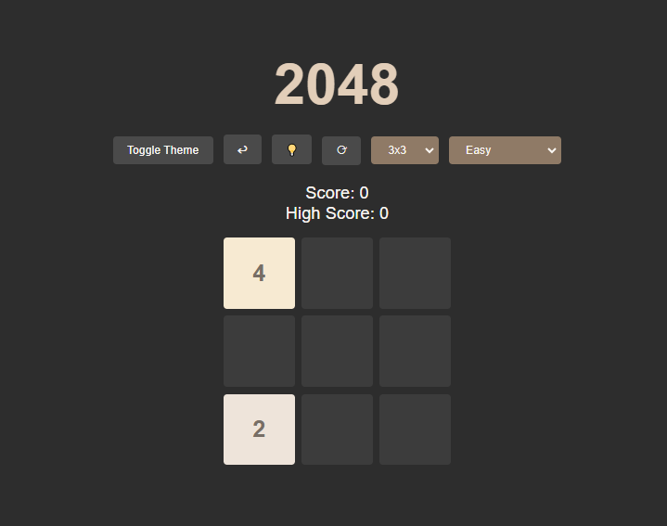
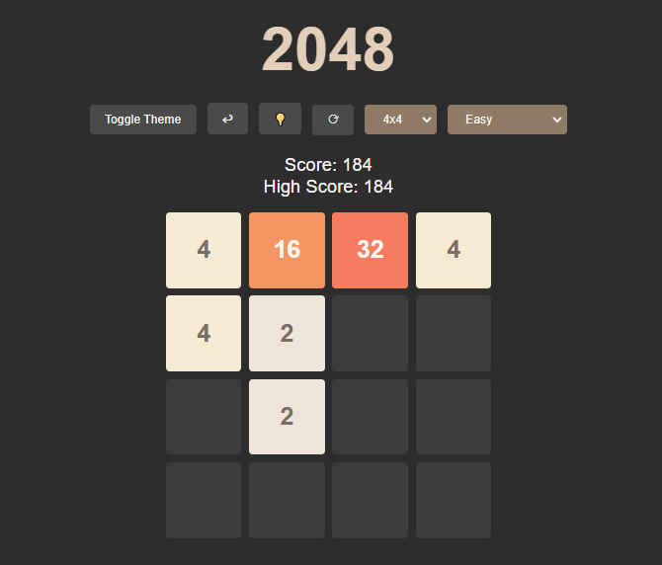
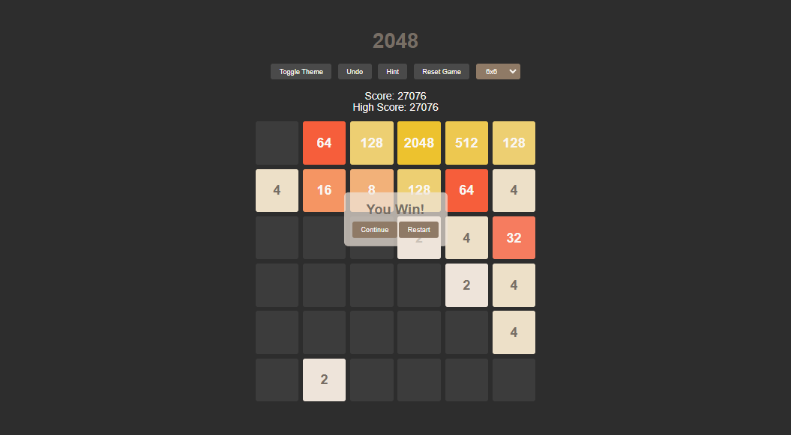
HIGH-LEVEL APPROACH
Game Grid and Tile Management
Tile Movement Logic
Check for Game Win

Slide 11











ROADMAP OF TASK
Project
Setup
Create HTML
Structure
CSS Layout and
Styling
JavaScript for
Game Logic
Score and
UI Enhancements
Game Over
& Restart
Handling
User Input
Game
Mechanics
Final Testing
and Debugging
Deployment

Slide 12

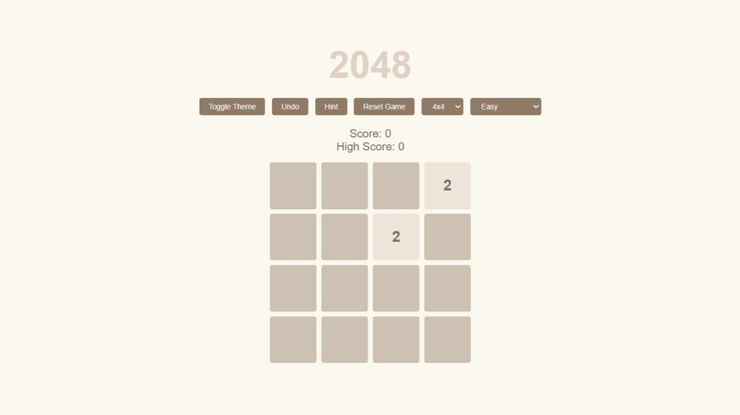
SCREENSHOT
THIS SCREENSHOT SHOW THE DARK AND LIGHT THEME OF GAME

Slide 13
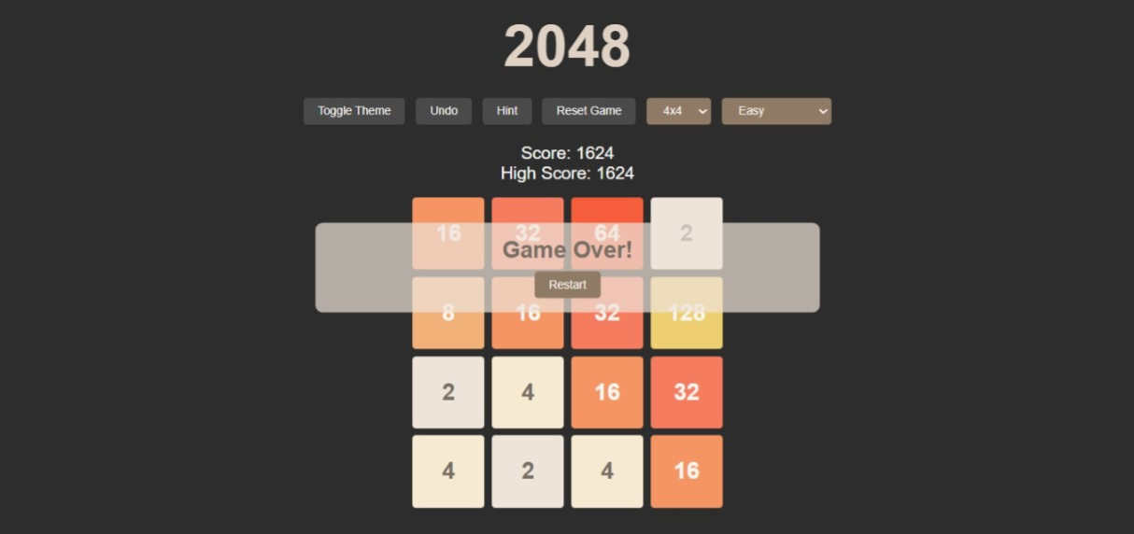
THIS SCREENSHOT SHOW THE “GAME OVER” BUTTON OF GAME

Slide 14
THIS SCREENSHOT SHOW THE “YOU WIN” MESSAGE AFTER WINNING THE GAME

Slide 15
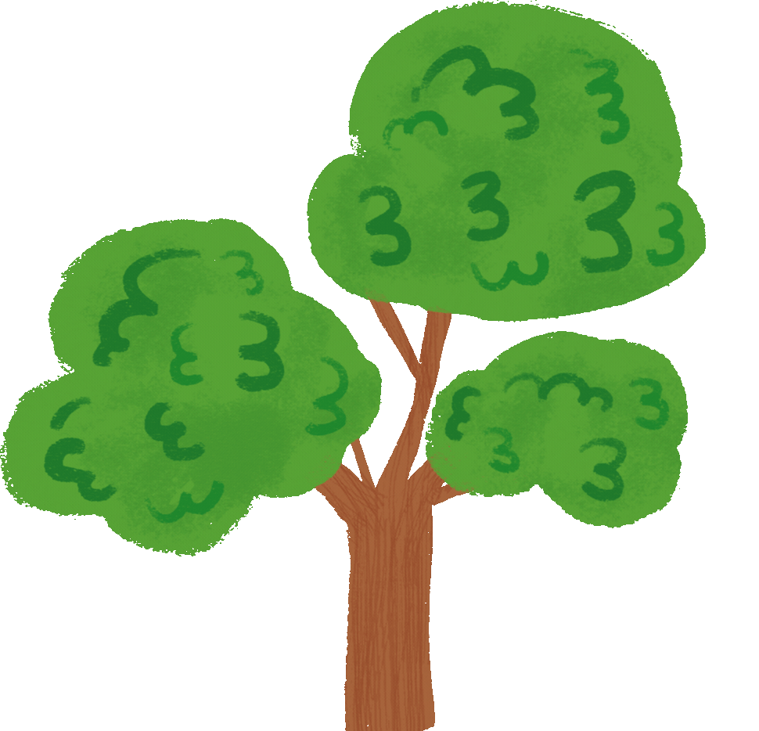
press
any key
FLOWCHART
no
is arrow
key
yes
moveup()
addrandomtile()
isarrow
up?
is”win
screen”?
no
is”game
over”?
yes
no
movedown()
isarrow
down?
yes
yes
yes
show
“you win”
show
“game over”
no
moveleft()
isarrow
left?
yes
no
end
moveright()
isarrow
right?
yes

Slide 16

FUTURE ENHANCEMENT
Enhanced Gameplay & User Experience.
Improved AI & Strategic Depth
Accessibility & Platform Expansion
Addressing the Endgame Problem

Slide 17

THANK
YOU

